Slide 1
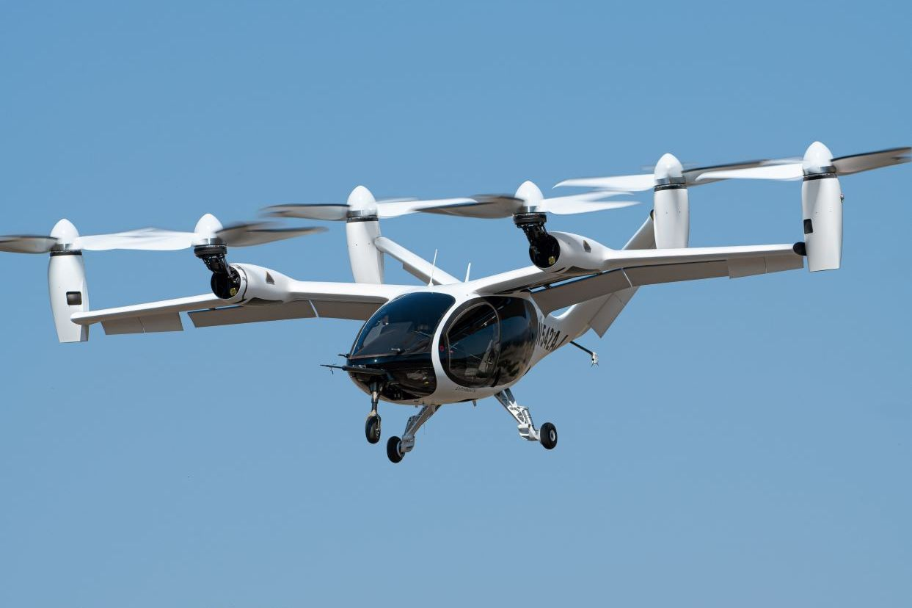
An analysis of Air taxi implementation in nyc
Annie cheng
Dec 1, 2022

Slide 2
Background & Problems
Background:
NYC has long standing traffic problems: congestion, parking difficulties, aging infrastructure of subway
Air taxis are small commercial airplanes used for short flights between locations in a city
These aircraft are also referred to as electric Vertical Takeoff and Landing (eVTOL) aircraft, which have the potential to change the mode of transportation
Approach from a startup perspective who wants to pitch this new mode of transportation in NYC to venture capitals and attract investment
Problems:
Lack of estimation of demand
Lack of understanding of the operation
Lack of projection of the market value and potential gain
Notes:
Safety problems of subway
Whether you are a student, a professional, NYC commuters experience these problems everyday
Get from one point to another quickly for an important meeting, or event, or family emergency – feel impossible
Unreliability creates a huge anxiety for people
As electric vehicle technologies advanced in the past years, electric powered aircraft.
(Joby, lilium, archer)
Though the evtol companies have presented prototypes, there’s no current large scale implementation of the technology.
Who operate? How do we maintain them? Where to we park them? How should we route them?

Slide 3
Objectives
This project answers the following questions:
What’s the estimated customer demand for air taxi in NYC?
Where do we build vertiports?
Is this a profitable business?

Slide 4
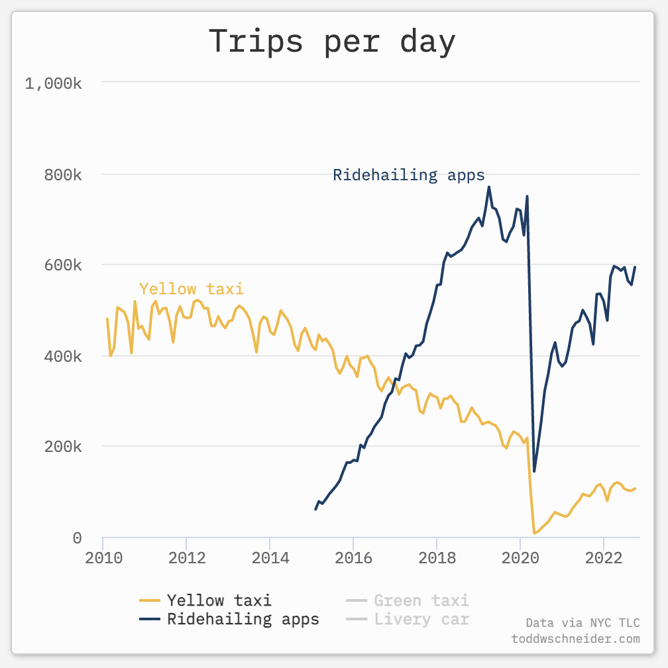
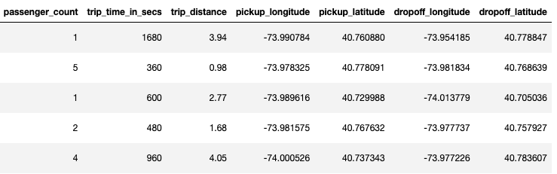
Data
Data source: New York City Taxi Trip Data from UIUC http://dx.doi.org/10.13012/J8PN93H8
I chose one month in 2013 for analysis (in total 14m data points with 14 fields).
This is a comparable estimate to the demand today.
Comparing taxi demand over the past 10 years
Dataset sample
Notes:
Data citation:
Donovan, Brian; Work, Dan (2016): New York City Taxi Trip Data (2010-2013). University of Illinois at Urbana-Champaign. https://doi.org/10.13012/J8PN93H8
Picture source:
https://toddwschneider.com/dashboards/nyc-taxi-ridehailing-uber-lyft-data/

Slide 5
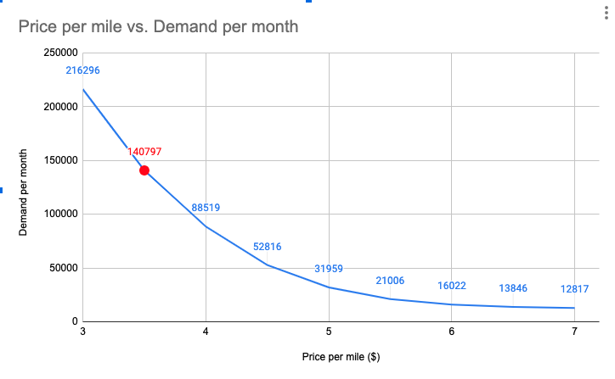
Customer demand is strongly correlated with price
A passenger would only pick the mode of air taxi if the value of time saved is greater than the increase in fare
Current estimation of air taxi price is between $3-$7 / mile.
We explored the effect of the change in price on demand and picked $3.5 for further analysis.
Notes:
https://www.flyingmag.com/evtol-air-taxi-passenger-prices/
Assumptions:
$50/hr as value of time
Calculation of taxi fare
Calculation of air travel speed
df2['travel_time_by_air'] = round(df2['haversine']/50*60+4).astype(int)
df2['time_saved'] = df2['actual_trip_time_in_min'] - df2['travel_time_by_air']
df2['estimated_taxi_fare'] = 2.5+1.56*df2['trip_distance']+.5*df2['actual_trip_time_in_min']
df2['value_of_time_saved'] = df2['time_saved']*50/60
df2['estimated_flight_fare'] = air_price_per_mile*df2['trip_distance']
df2['take_air_taxi'] = (df2['value_of_time_saved'] > (df2['estimated_flight_fare']-df2['estimated_taxi_fare']))

Slide 6
Estimate air taxi demand
Number of data | Percentage | Note
14,776,614 |  | All data points in the dataset
14,511,511 | 1 | Cleaned invalid data points
326,546 | 2.25% | Air taxi trip for only haversine distance >10
140,797 | 0.97% | Comparing value of time saved to increase in fare
131,238 | 0.90% | After finding the 20 vertiports, only pick trips that have origins and destinations to be within 2 miles of the vertiports
109,513 | 0.75% | Considering the passenger counts
3,650 | 0.75% | Converting monthly demand to daily demand
We estimate the daily air taxi demand is 3650 is NYC, which is 0.75% of all taxi demand.
Among those demand, the average travel time by car is 45 min, average travel time by air is 19 min, and average time saved is 26 min.
On average, passengers need to travel 0.5 mile to get to and from the vertiport.

Slide 7
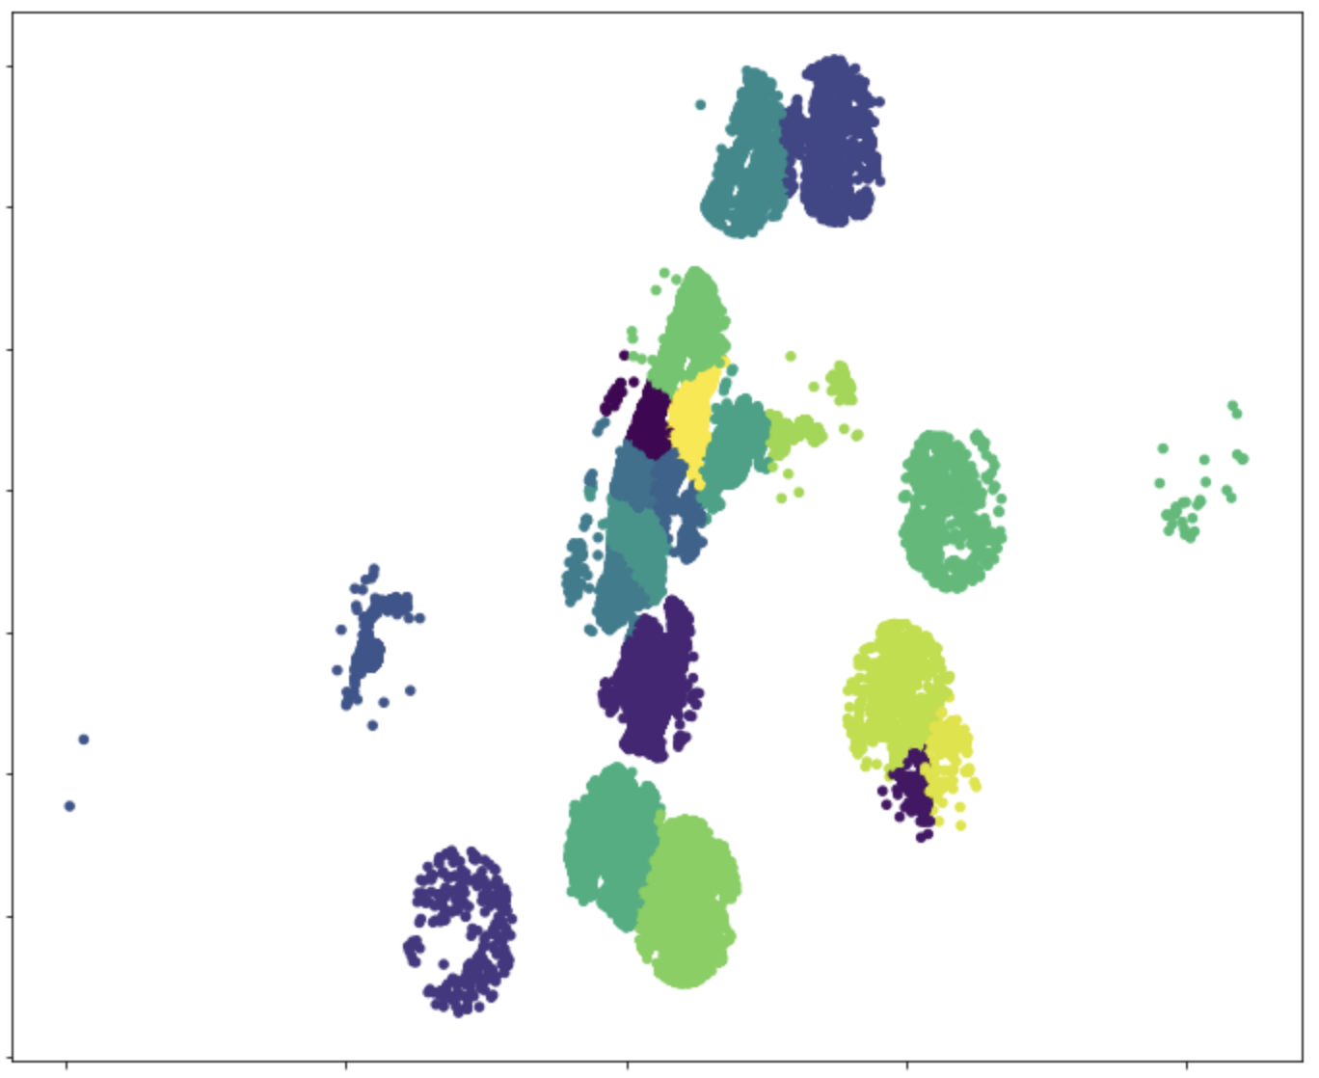
Demand visualization
Visualizing all feasible demand and their takeoff, landing vertiports

Slide 8
Implementation
A payback period of 5 years
20 vertiports
100 eVTOLs
Consider operations & maintenance cost
Consider battery & charging
Consider pilot & insurance
Revenue = $321M
Cost = $210M
Profit = $111M

Slide 9
Conclusions & Future directions
Conclusions:
The estimated daily demand is 3650 trips in NYC, which makes up of 0.75% of total taxi demand.
We build the 20 vertiports where the demand is most clustered.
From preliminary analysis, we see air taxis could be a fast, safe, cost-effective, profitable market to enter and has a large potential.
Future Directions:
Estimate demand by time of day, day of week, and seasonality. Use more data available.
Incorporate more realistic considerations in building the vertiports, such as the exact location and feasibility.
Consider combining different modes of transportation and the options of using other means to get to the vertiports.
Do more research on the cost and validate previous numbers.
Notes:
More data for more accurate estimation
Car, bike, scooter

